Slide 1
Project Overview
Using 101 real life quantitative trading alphas (96 delay-1 alphas)
What have we done?
Data gathering (Bloomberg, Polygon API, Filters)
Python programming(Pandas, Numpy, Linear Algebra)
Alpha tables
Sample space & supporting functions
Examined how alpha returns scale vs their own volatility and turnover
Analyzed the cross-section of pairwise alpha correlations
Tested whether each alphas is statistically significant.

Slide 2
Motivation
Practical relevance for markets and risk management.
Real world portfolio management and risk management approaches.
Building a reusable, research-grade modeling framework.
Hands on modeling using advanced tools and analysis..
Understand how real systematic trading works end-to-end,
Moving beyond the textbook example and to see how modern quant desks operate.

Slide 3
Project Workflow
Alpha Pipeline
Alpha Generation
(96 alphas computation)
Alpha Evaluation
(IC, Rank IC)
Alpha Validation
(hypothesis test, autocorrelation test)
Alpha Scaling
(IC-IR)
Data Pipeline
Data Collection
(prices, volume, etc.)
Data Preprocessing (log return, sample space)
Feature Engineering (supportive functions)
Portfolio Pipeline
Portfolio Construction
(alphas to portfolios)
Execution and Trading Strategy
(long, short, etc.)

Slide 4
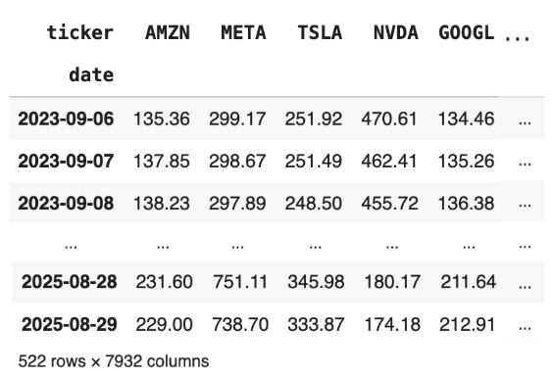
Data Collection
Data Source:
NYSE, Nasdaq → Open, High, Low, Close Price, Volume, Amount, Dividend, Stock Split
Bloomberg Terminal → Sector, Industry, Sub-Industry (GICS Classification)

Slide 5
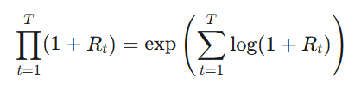
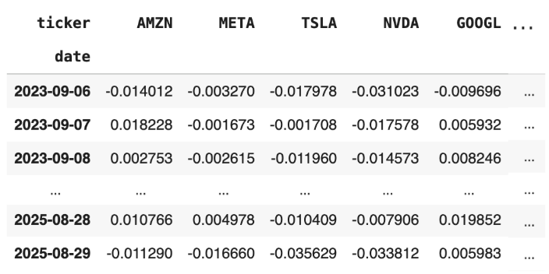
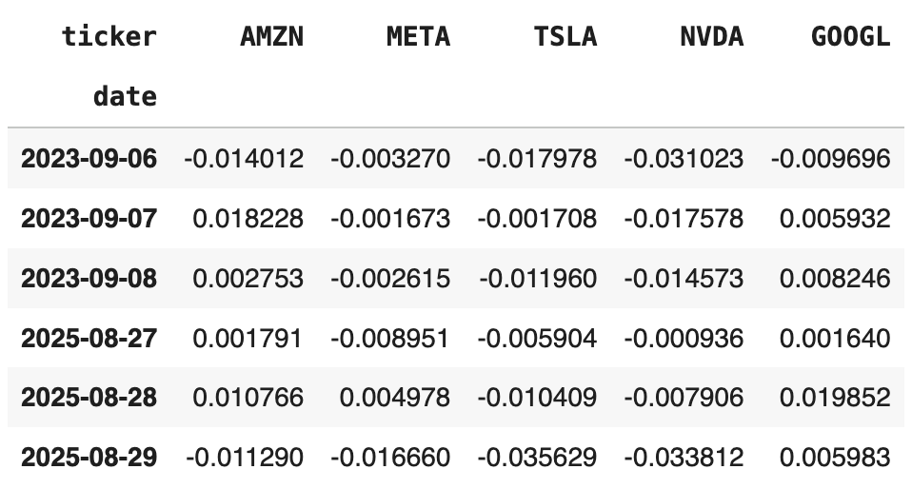
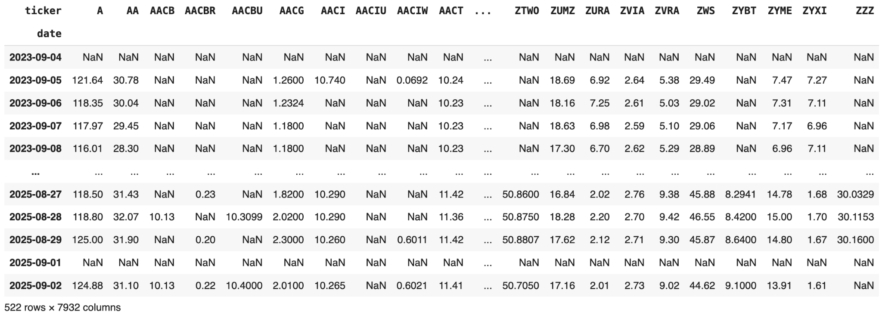
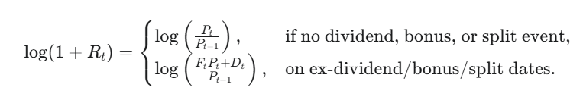
Log Return
Log Return Formula :
Why do we use Log Return?
Notes:
Application of LogReturn
How it is used in calculation. Give example.

Slide 6
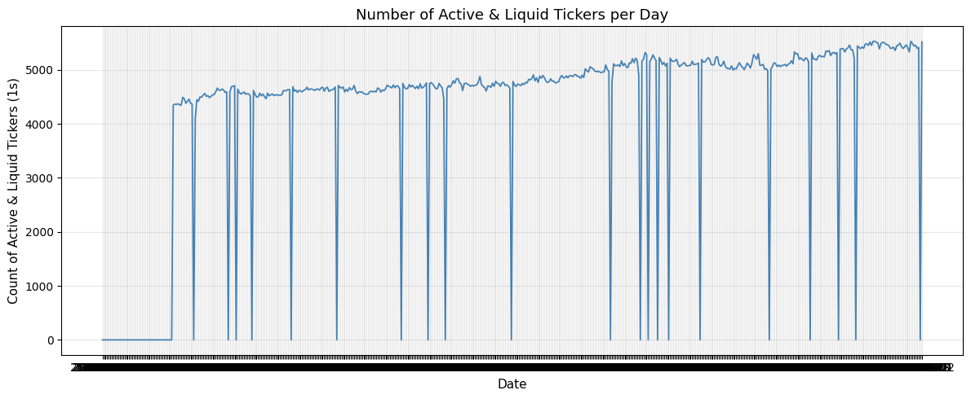
Sample Space
Sample space criteria :
>60 trading days
Liquidity constraint
Removed NAN
Key point:
Assess the data prior to day_{t} (day_{t+1} and before)

Slide 7
Supporting Functions
Maps observable market occurrences to signals
rank- standardize stock value into percentile rank for each time
delay- retrieves stock’s value a number of days before
helps with momentum or reversal signals
corr- checks whether 2 stocks moved together in given time period

Slide 8
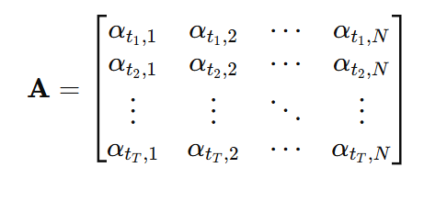

Alphas
Hypotheses about market behavior
Momentum- Stocks that have recently outperformed continue to perform well.
Mean-reversion- Prices that move too far from equilibrium tend to revert
Volatility- Captures shifts in realized or implied volatility to predict short term corrections.
Liquidity- Trades on changes in trading volume or bid ask spreads.

Slide 9

Information Coefficient
Construct the Information Coefficient (IC, RIC)
Hypothesis test the statistical significance of the mean IC (H0: mean_ic <=0 and HA: mean_ic > 0 for alphas with mean_ic >0, and vice versa for alphas with mean_ic < 0)
Does the alpha time t-1 have predictive power over the return at time t?
Since none of the standard assumptions hold, we use the Newey-West HAC (Heteroskedasticity and Autocorrelation Consistent) Standard Error estimator

Slide 10

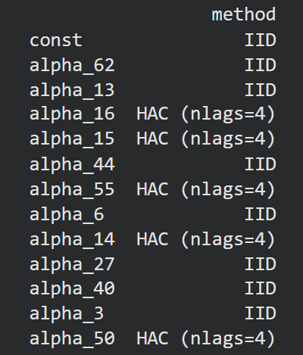
Information Coefficient
For a given alpha ell, gamma_t is autocovariance of the IC, w_l are weights that decay, and L is a cutoff param
To find L, we use the ACF and PACF tests. This is also important to see if our alphas are in a heteroskedastic and autocorrelation regime or IID regime

Slide 11
Alpha Filtering
Once we have our (HAC) SE estimator, we conduct a single tail hypothesis testing for the mean_ic’s significance
This filters out 87 alphas, and below is a stats report of alphas with highest mean_ic, HAC filtering method, and lowest mean_ic
alpha | n_ic | mean_ic | t_stat_ic | p_value | se_method
alpha_16 | 153 | 0.016889 | 0.002676 | 1.4e-9 | IID
alpha_15 | 153 | 0.012314 | 0.002337 | 2.3e-07 | HAC (nlags=5)
alpha_5 | 116 | -0.022782 | -3.011303 | 1.6e-03 | IID

Slide 12
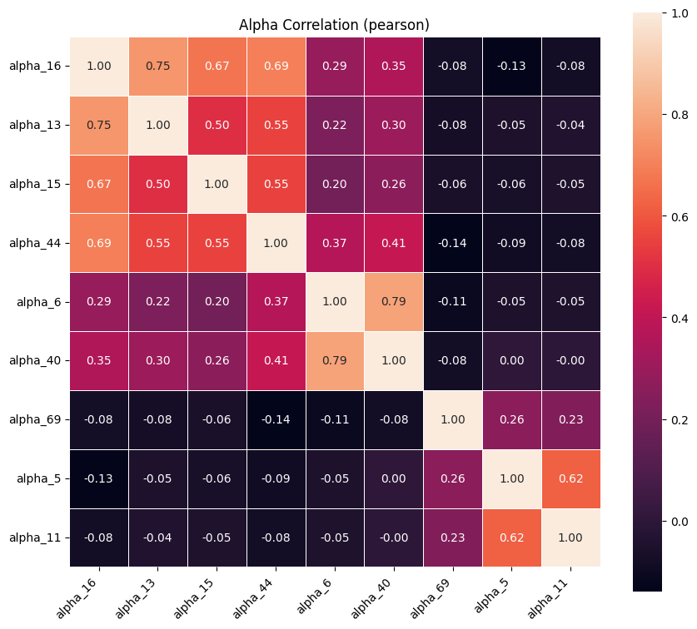
Alpha Correlation Heatmap

Slide 13

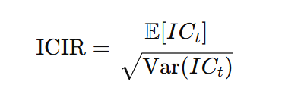
Constructing the trading strategy
(long only)
Statistically significant Alphas: 16, 13, 15, 44, 6, 40, 69, 5, 11
Standardization: Cross-Sectional z-score (day t) for alpha j:
ICIR: Information Coefficient Information Ratio,
Used for scaling each alpha value based on its strength.
It also flips the sign of alphas with negative IC value.

Slide 14
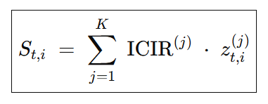
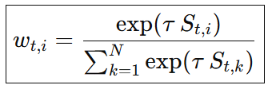
Final per-stock score (day t):
SoftMax Weights: Used to give more weightage to the most significant stocks.
Notes:
Tau = Scaling parameter

Slide 15
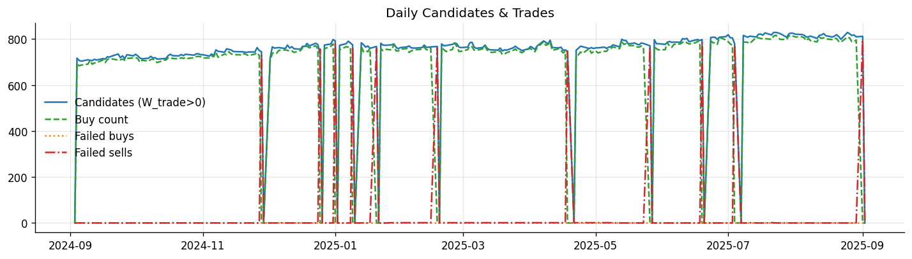
Daily Alpha Candidates and Trade Executions

Slide 16
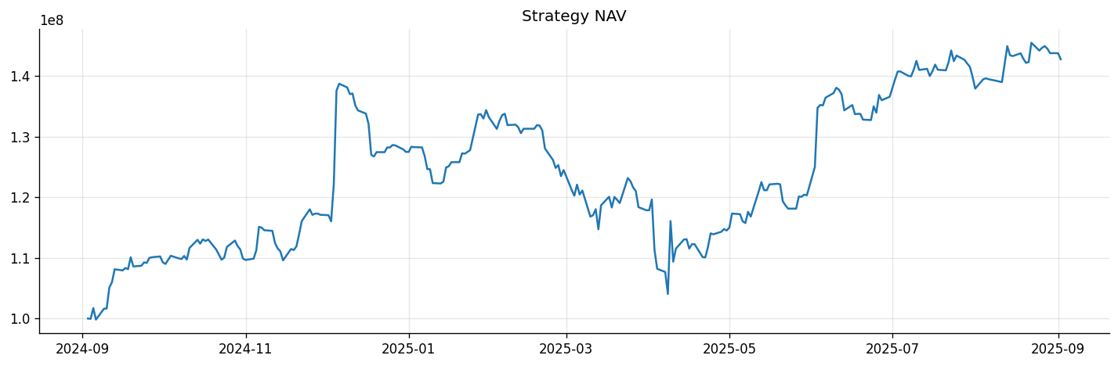
Multi-Alpha Strategy NAV

Slide 17
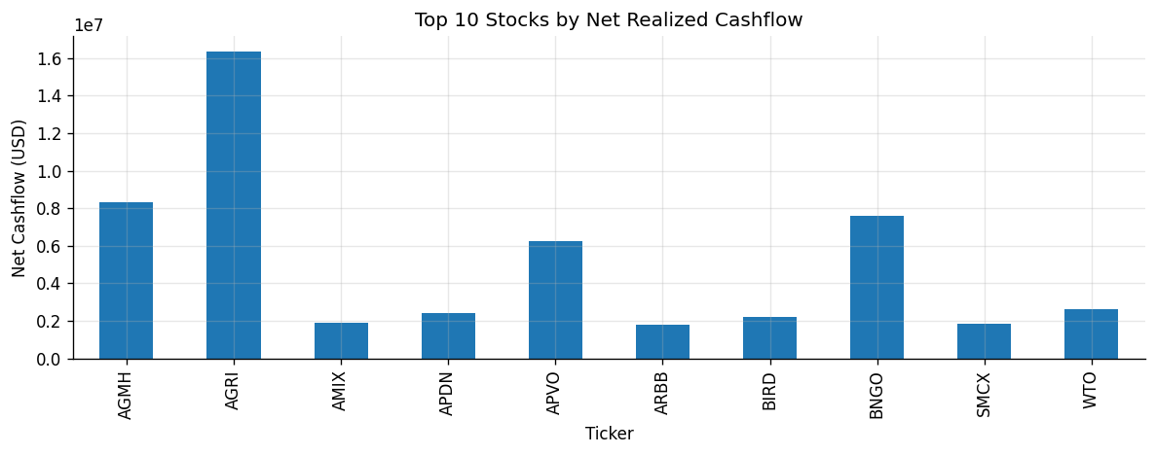
Top 10 Stocks by Net Realized Cashflow

Slide 18
Back-Testing Report
Start NAV : 100000000.00
End NAV : 142749181.01
Total Return : 42.75%
Annualized Return : 42.89%
Annualized Vol : 28.85%
Sharpe Ratio : 1.49
Max Drawdown : -24.99%

Slide 19
Thank You

